Slide 1

Hydroraking Sub-committee
Dave McDonald Dana Dudley
Ron Pearson Tom Nowd
Suzanna Dudley Bob Novacek
Phyllis Andella Mario Andella
Mike Nault Jim LeBlanc
March 4, 2009

Slide 2
Topics
Objectives
Goals
Proposed hydroraking methods
Benefits
Open discussion
Appendix

Slide 3
Objectives
Pros and cons of hydroraking
  What’s involved?
Identify areas to be hydroraked
Determine method of discarding debris
Identify hydroraking companies
Costs and expenses
  Permits
  Cost of hydroraking

Slide 4
Goal
Determine if hydroraking is a feasible lake management technique for Hickory Hills Lake

Slide 5
How Hydroraking functions
Equivalent of a floating backhoe
Outfitted with a raking tool that removes thick root masses and associated sediment and debris
Can be used for removing stumps, water lily root masses and other debris
Can be used with the weed harvester for transporting debris to a shore location for pickup and disposal

Slide 6
Benefits
Removes vegetation difficult to harvest by other means
Allows removal of leaves, stumps, or other obstructions
Can navigate in very shallow water

Slide 7
Detriments
May spread plants that reproduce by fragmentation
  Although, plants will not grow in areas of strong current
  Can be controlled with turbidity screen
May generate high turbidity and alter habitats in the work area
  Control turbidity by using turbidity screens
  Monitor turbidity around the hydroraking area before, during, and after hydroraking
Disposal – Where? See debris removal on page 9
Not a permanent solution

Slide 8
Factors favoring the use of this technique
The target species has dense root masses but usually only occupies only a small part of the lake
Underwater obstructions are targeted for removal
Suspended sediments resettle quickly and leave minimal residual turbidity
Convenient access for equipment and trucks and a nearby location for plant disposal are available
  Use weed harvester to transport debris

Slide 9
Debris removal
Use weed harvester for transporting
Suggestions for removal and pickup are:
  Across personal property
  Horizon Island Road causeway
  Store and dried on Hickory Hills pr0perty or on personal property (with permission from owner) for discarding
  Placed in dumpsters for immediate removal
  Compost pile
    Free compost for gardens and lawns
    Sold to local nurseries
    Town may have uses for the compost

Slide 10
Definition and Cost estimate from Aquatic Control Technology Inc.
The Hydro-Rake is essentially a floating backhoe with hydraulically powered paddle-wheels.
It is contracted on an hourly basis for $185/hour with a lump sum mobilization charge of $1,000-$1,500.

Slide 11
Future
Need cost estimates and information from other hydroraking company/s (if any)
Permitting costs
Water testing, if any is needed?
  See chart on following page
  May need heavy-metal test prior to hydroraking
Liability insurance for Hickory Hills lake shareholders, if needed?

Slide 12
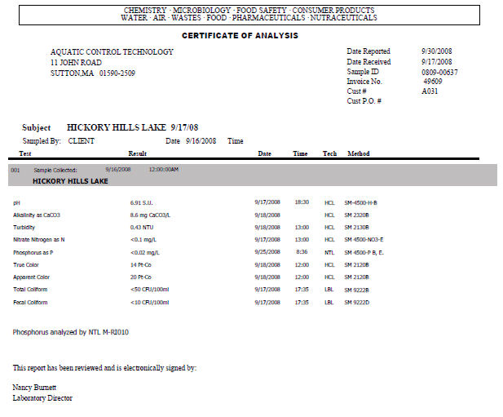

Slide 13
Hydroraking meeting 3/4/09 Open discussion
Pros and cons
Can be used for dredging
Discarding the unwanted materials
Hire company for a test site.
  Use Island Road Mulpus brook tributary as test site
  Remove large piles of debris from trap near mouth.
  Remove aquatic plants downstream from trap so water will flow freely (so floating objects will not lodge in aquatic plants)
Contact Aquatic Technologies for additional info?
Some hydroraking costs can be paid by donations

Slide 14
Subcommittee statement
In our opinion, hydroraking would greatly benefit the residents of Hickory Hills lake.
Although mother nature usually provides its own maintenance, sometimes she needs help.

Slide 15
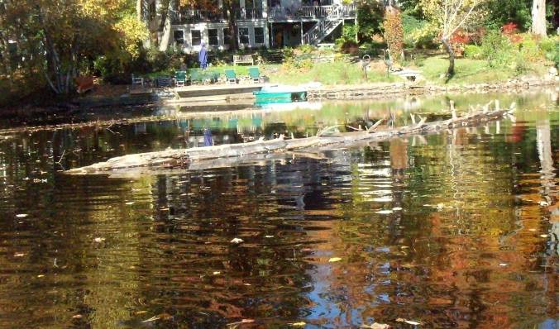
Appendix A – Photo at mouth of Mulpus brook showing debris

Slide 16

Stumps and debris that washed down Mulpus brook

Slide 17
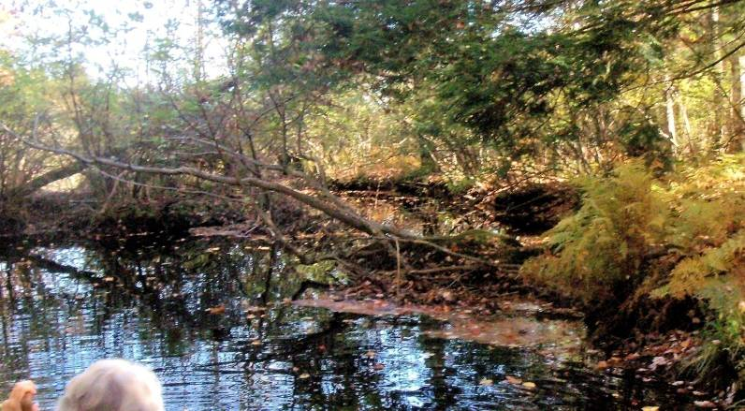
Secondary egress caused by beaver dam water diversion & subsequent washout

Slide 18
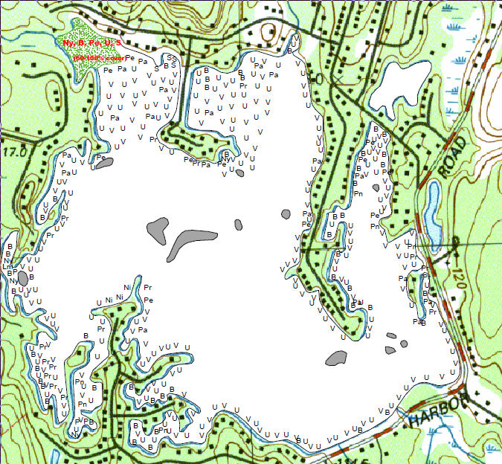

Slide 19
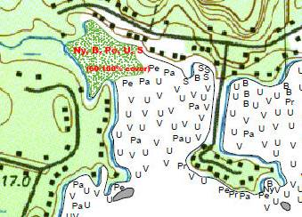
Hydroraking test area
Mulpus brook tributary test area
Horizon Island

Slide 20
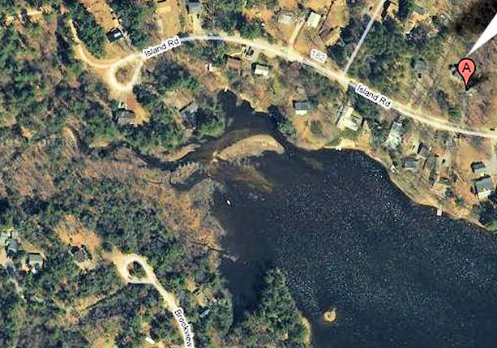
Mulpus tributary showing silting @2006

